Slide 1
Unit - 5
Network Layer
Prachi Shah
IT Dept.
BVM

Slide 2
Contents
1. | Network Layer Design Issues | [From Attached PDF]
2. | Routing Algorithms: Shortest Path Routing, Flooding, Distance Vector Routing, Link State Routing, Broadcast, Multicast routing | [From Attached PDF as well as Forouzan Ch-22]
3. | Congestion Control Algorithms | [From Attached PDF as well as Forouzan Ch-24]
4. | Quality of Service | [Forouzan Ch-24]
5. | Example protocols: OSPF, BGP | [Forouzan Ch-22]
6. | Internet multicasting IPv4 and IPv6 | [Forouzan Ch-20]
7. | IPv4 Addresses & NAT | [Forouzan Ch-19]

Slide 3
Network Layer Design Isues
Store-and-Forward Packet Switching
Services Provided to the Transport Layer
Implementation of Connectionless Service
Implementation of Connection-Oriented Service
Comparison of Virtual-Circuit and Datagram Subnets

Slide 4
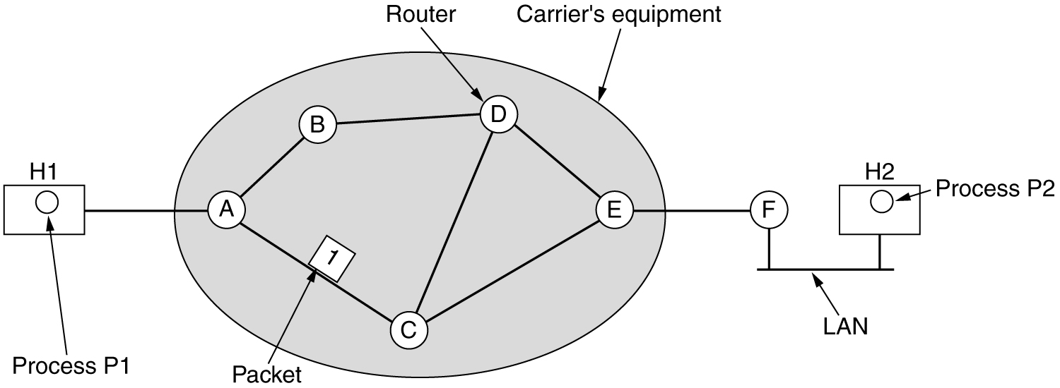
Store-and-Forward Packet Switching
The environment of the network layer protocols.
fig 5-1

Slide 5
Services Provided to the Transport Layer
Services should be independent of router technology
The transport layer should be shielded from (covered with) number, type and topology of routers present
The network addresses made available to transport layer should use a uniform numbering plan, even across LANs and WANs

Slide 6
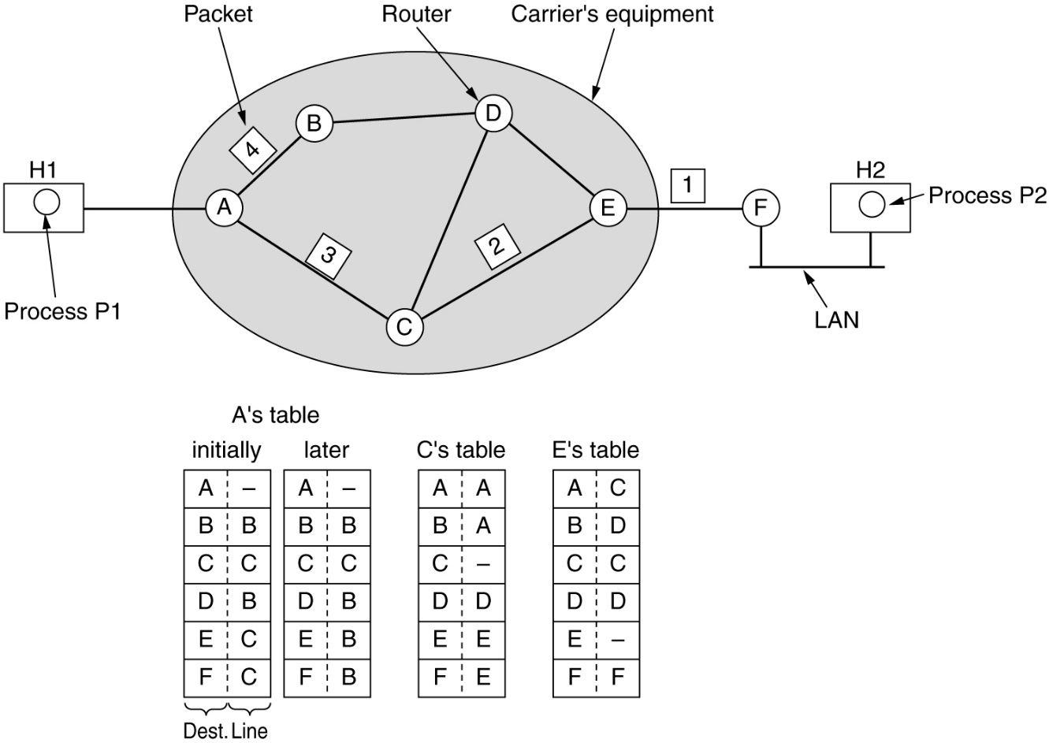
Implementation of Connectionless Service
Routing within a diagram subnet.

Slide 7
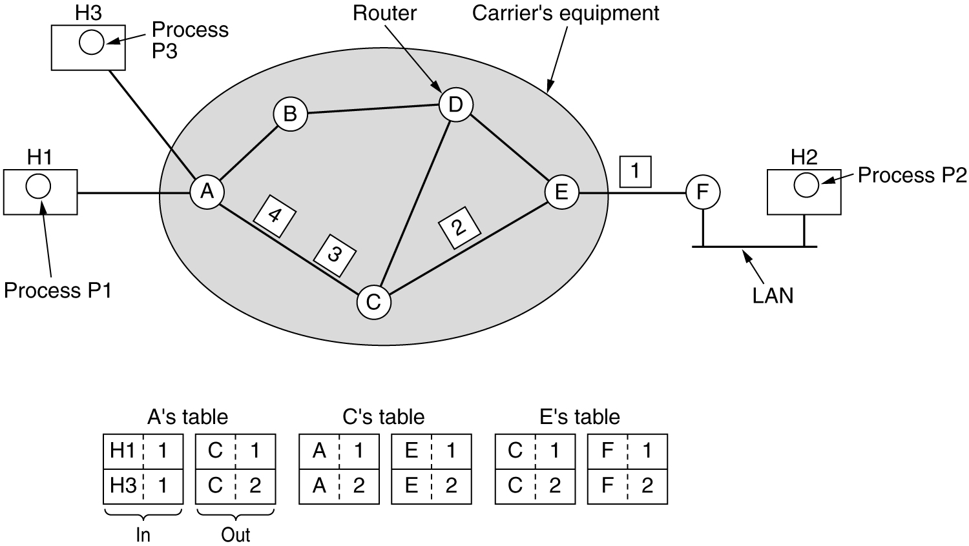
Implementation of Connection-Oriented Service
Routing within a virtual-circuit subnet.

Slide 8
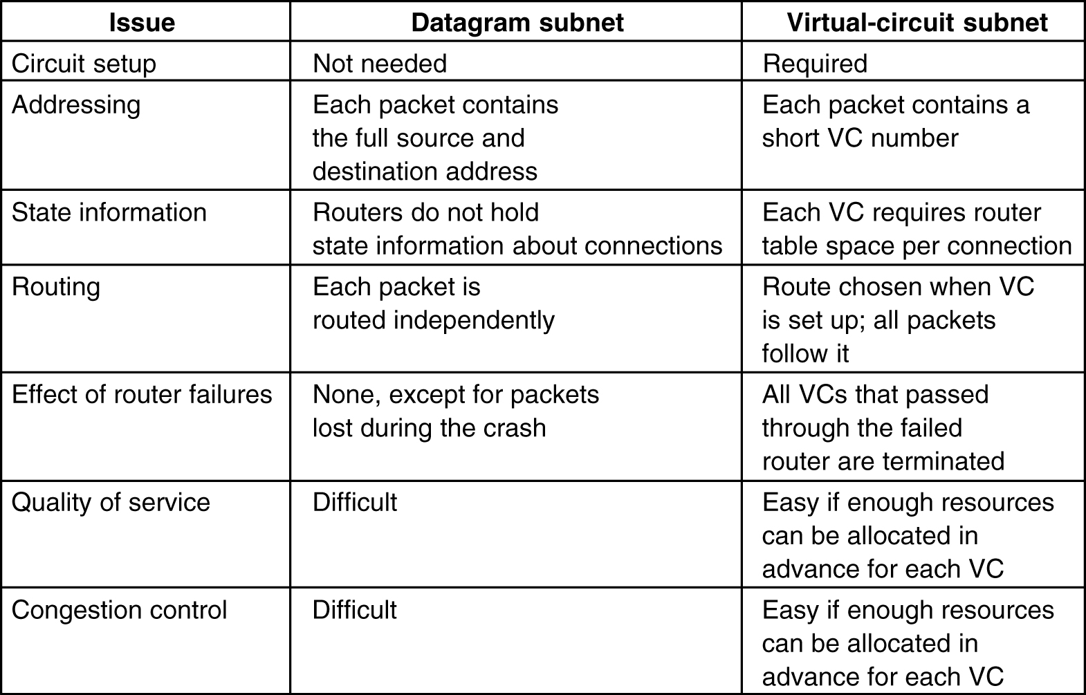
Comparison of Virtual-Circuit and Datagram Subnets
5-4

Slide 9
Routing Algorithms
The Optimality Principle
Shortest Path Routing
Flooding
Distance Vector Routing
Link State Routing
Broadcast Routing
Multicast Routing

Slide 10
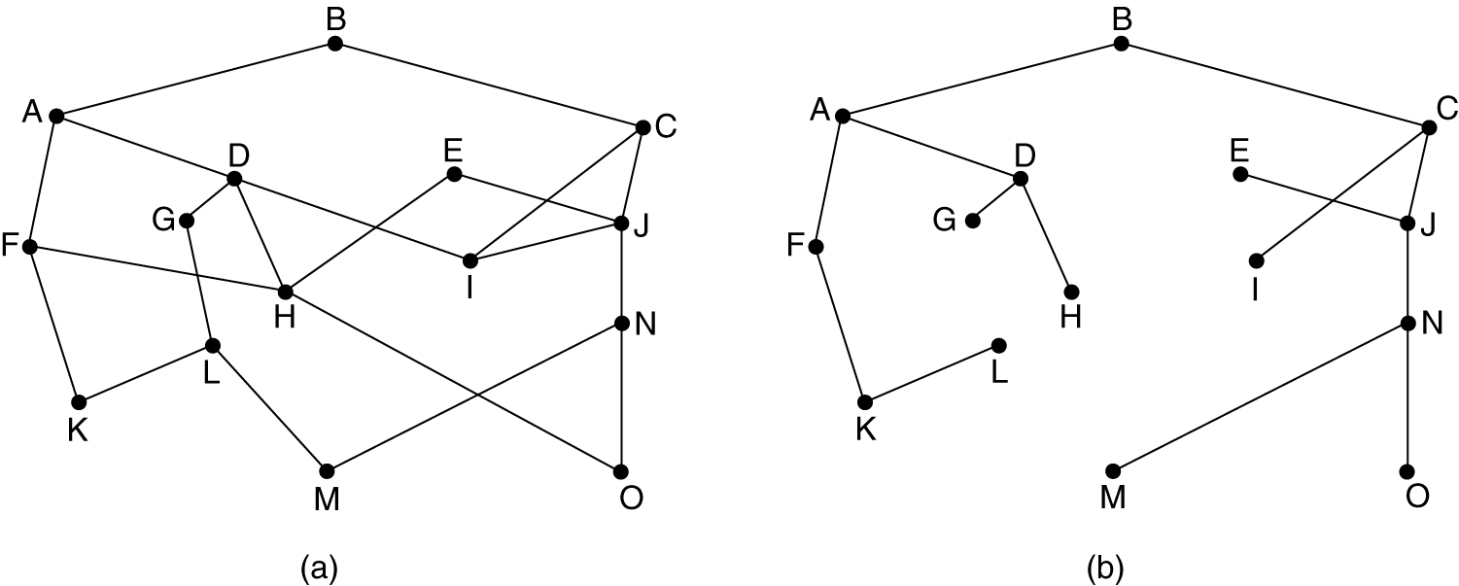
The Optimality Principle
(a) A subnet. (b) A sink tree for router B.

Slide 11
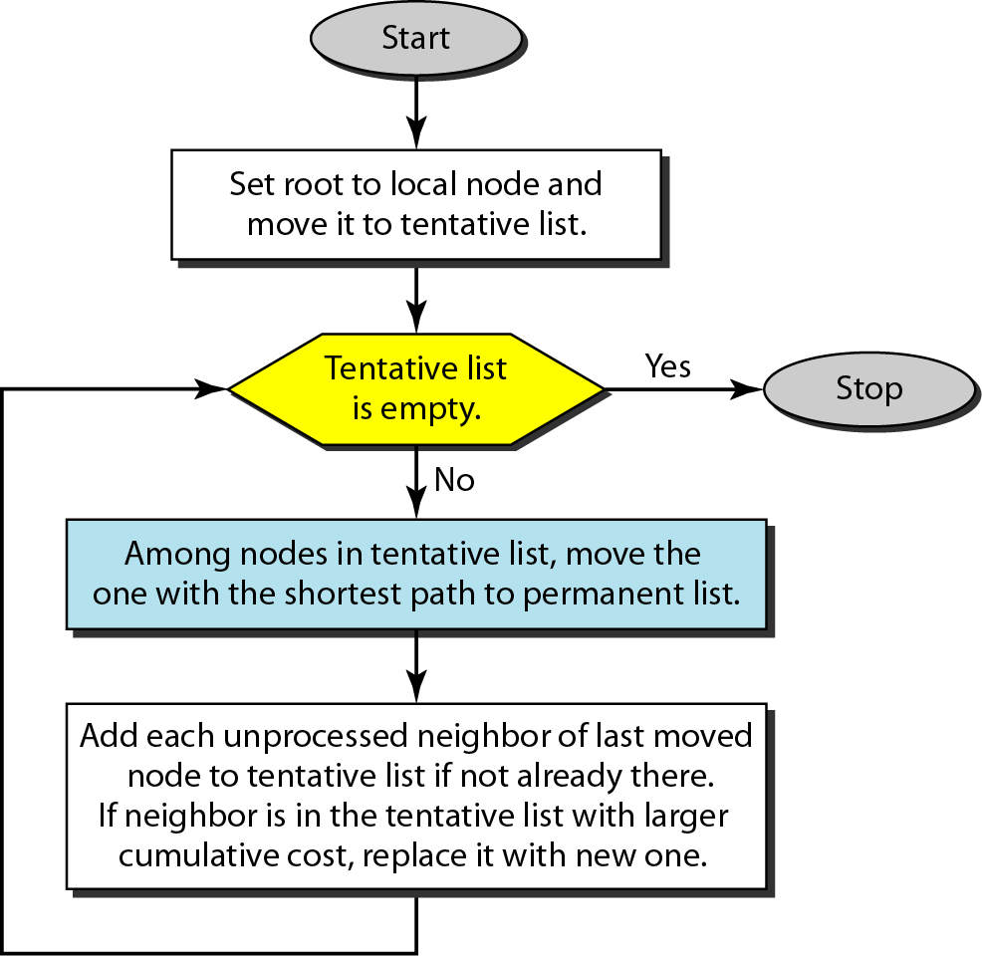
Shortest Path Routing
Also known as Dijkstra algorithm
Path length is measured using:
Number of hops
Geographic distance
Other metrics like mean queueing and transmission delay

Slide 12
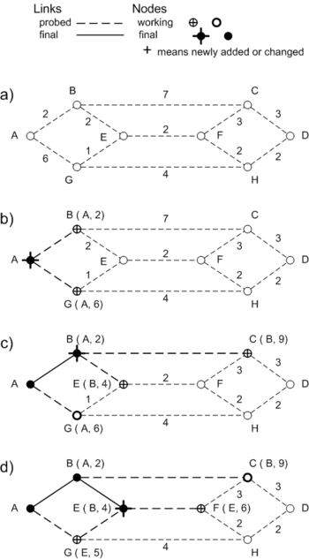
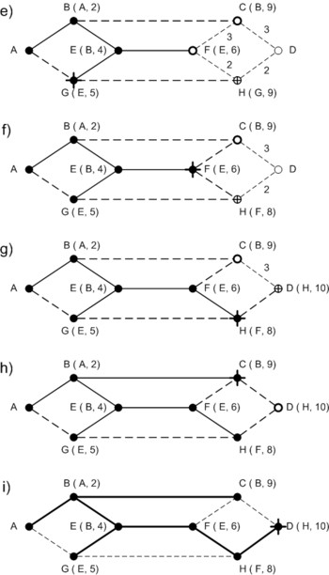
Shortest Path Routing

Slide 13
Flooding
Every incoming packet is forwarded on every outgoing link except the one it arrived on
Problem: duplicates
Constraining the flood:
Sequencing – Each packet is uniquely numbered at the source.
Hop count – Each time a node passes on a packet, it decrements the value by one. When its value becomes ‘0’, the packet is discarded.
Selective flooding – Exclude unreasonable links

Slide 14
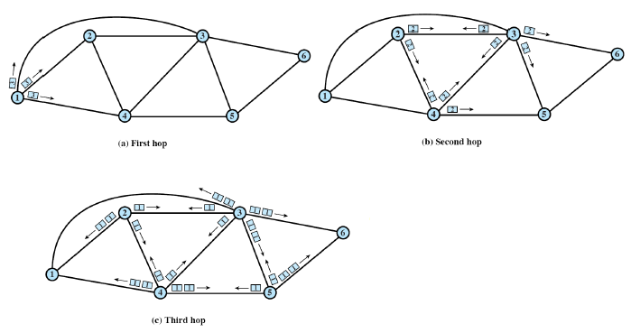
Flooding Example

Slide 15
Static Algorithms (Non-Adaptive)
Shortest-path routing.
Flooding.
Dynamic Routing (Adaptive Routing)
Distance vector routing.
Link state routing.

Slide 16
Distance Vector Routing
In distance vector routing, each node shares its routing table with its immediate neighbors periodically and when there is a change.

Slide 17
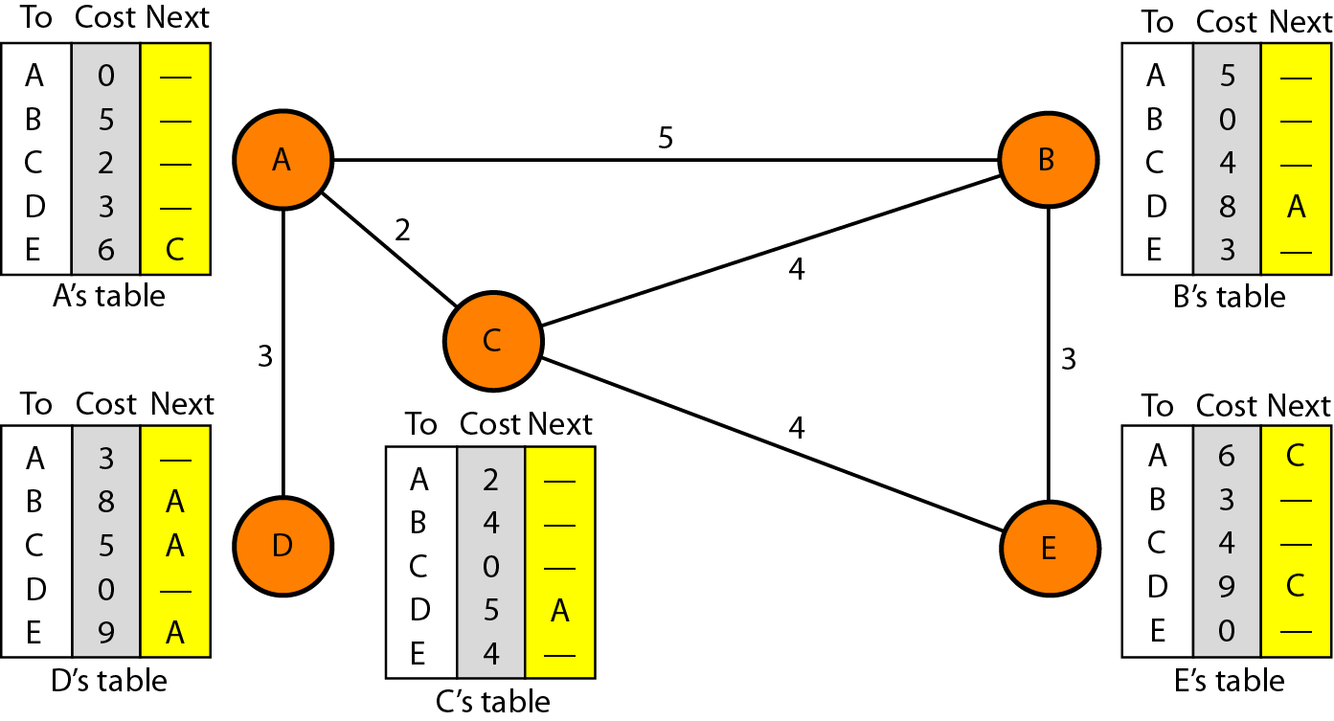
Figure 22.14 Distance vector routing tables

Slide 18
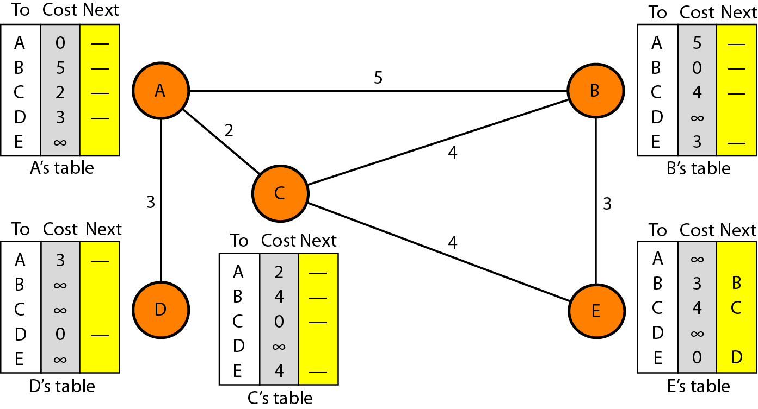
Figure 22.15 Initialization of tables in distance vector routing

Slide 19
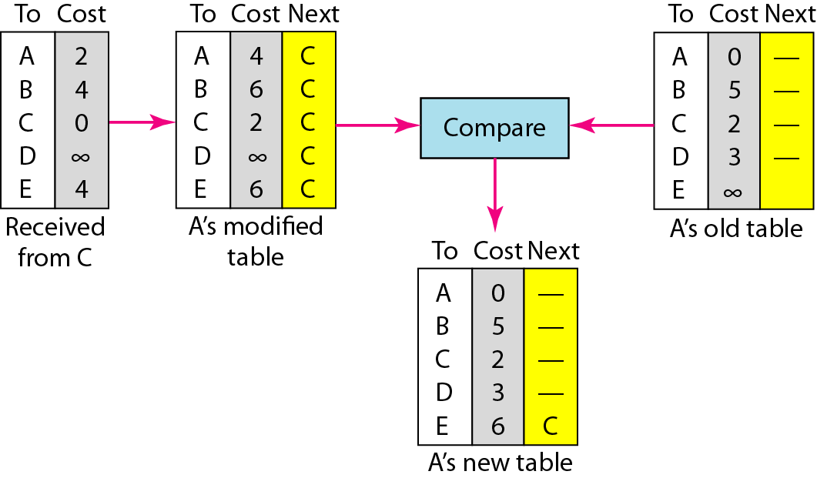
Figure 22.16 Updating in distance vector routing

Slide 20
Link State Routing
Each router must do the following:
Discover its neighbors, learn their network address.
Measure the delay or cost to each of its neighbors.
Construct a packet telling all it has just learned.
Send this packet to all other routers.
Compute the shortest path to every other router.

Slide 21
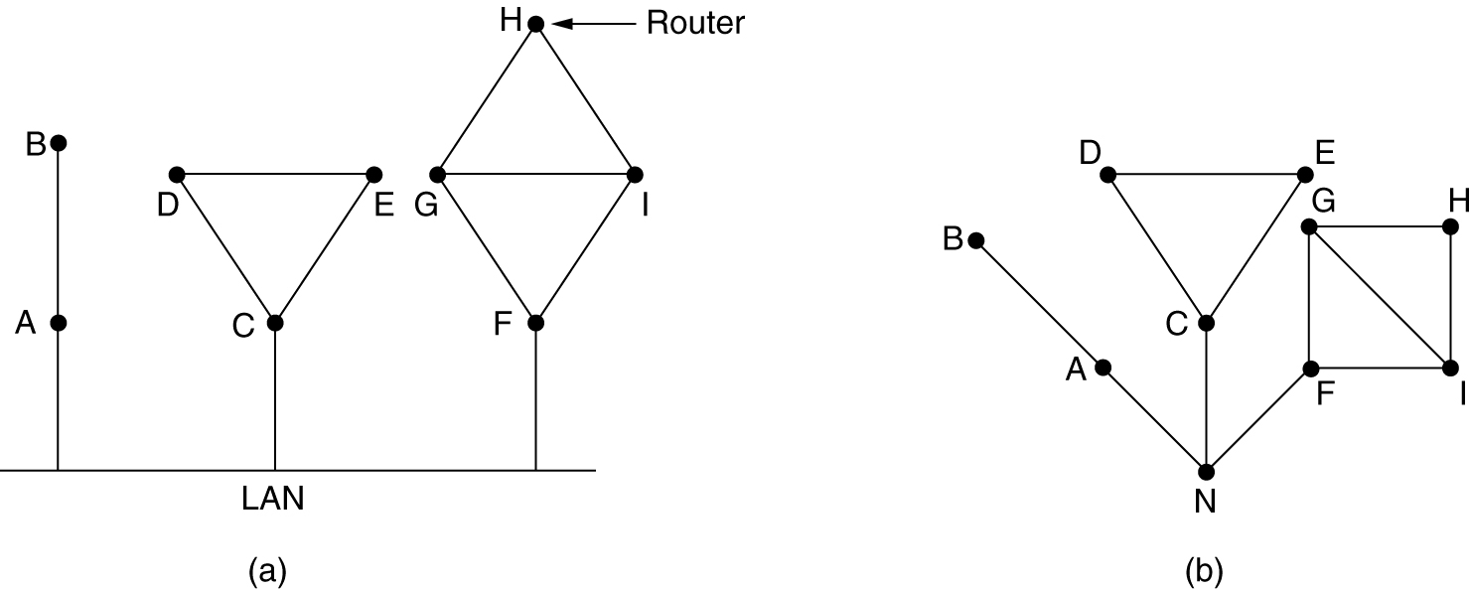
Learning about the Neighbors
Nine routers and a LAN.
A graph model of (a).

Slide 22
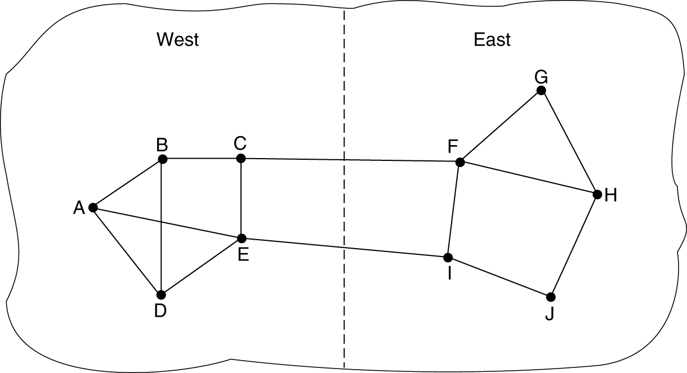
Measuring Line Cost
A subnet in which the East and West parts are connected by two lines.

Slide 23
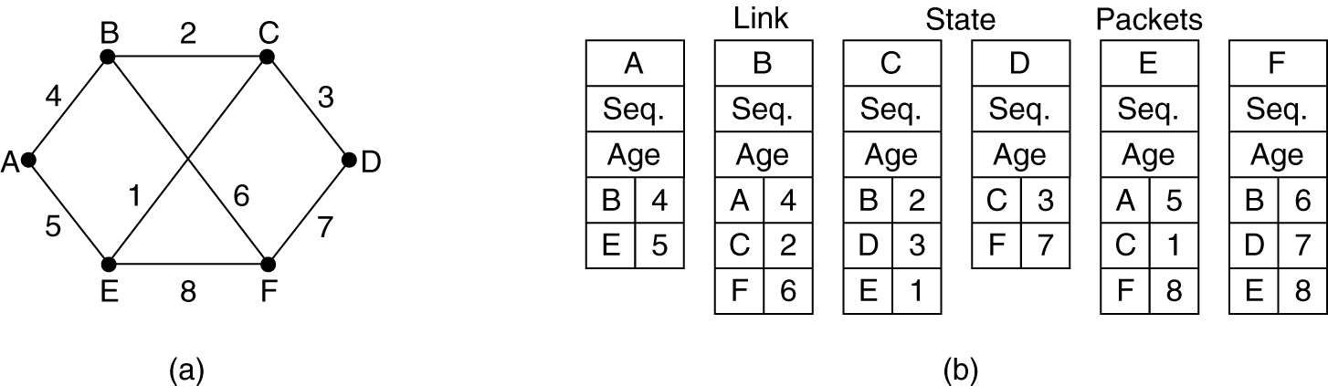
Building Link State Packets
(a) A subnet. (b) The link state packets for this subnet.

Slide 24
Broadcast Routing
It is the process of “Sending a packet to all destinations simultaneously”. Various methods are:
Send packet to each destination
Flooding – point-to-point routing algorithm
Multidestination routing – new packet for each output line to be used. (Each output line will contain the destination address that are to use that line)
Spanning tree
Reverse path forwarding

Slide 25
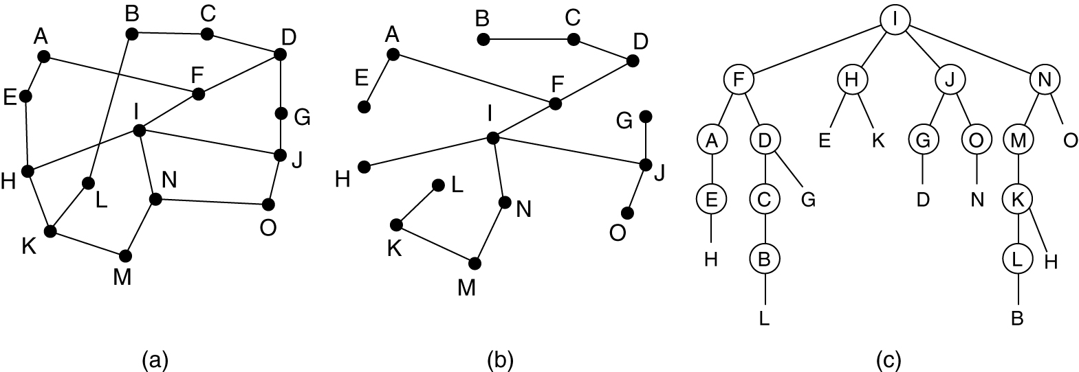
Broadcast Routing
Reverse path forwarding
(a) A subnet. (b) a Sink tree. (c) The tree built by reverse path forwarding.

Slide 26
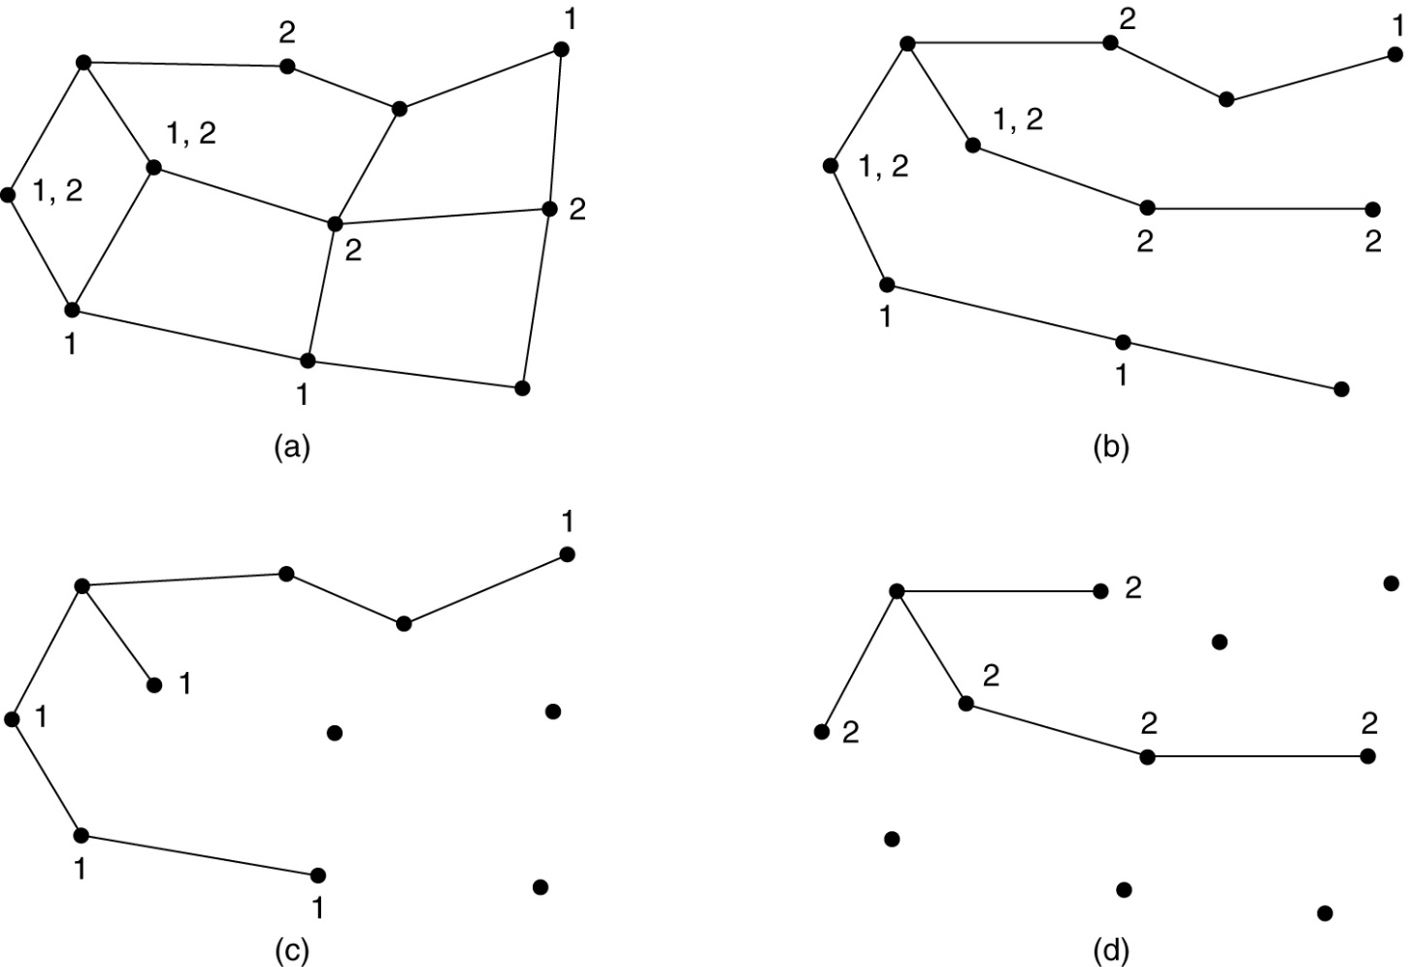
Multicast Routing
(a) A network. (b) A spanning tree for the leftmost router. (c) A multicast tree for group 1. (d) A multicast tree for group 2.

Slide 27
Congestion Control
Congestion control refers to techniques and mechanisms that can either prevent congestion, before it happens, or remove congestion, after it has happened.
In general, we can divide congestion control mechanisms into two broad categories:
open-loop congestion control (prevention) and
closed-loop congestion control (removal).

Slide 28
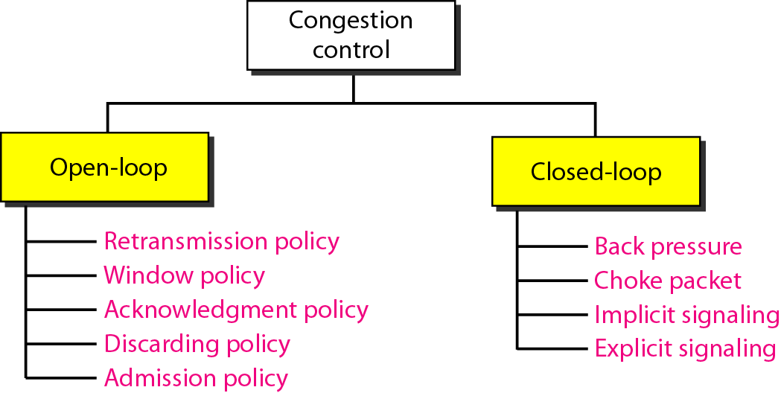
Figure 24.5 Congestion control categories

Slide 29
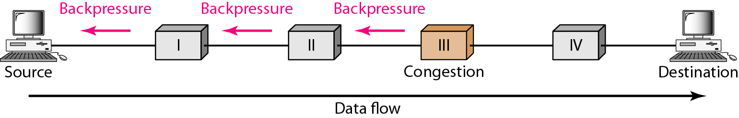
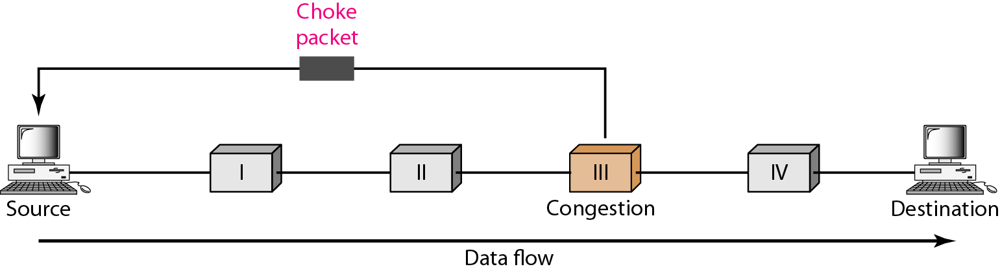
Figure 24.6 Backpressure method for alleviating congestion
Figure 24.7 Choke packet

Slide 30
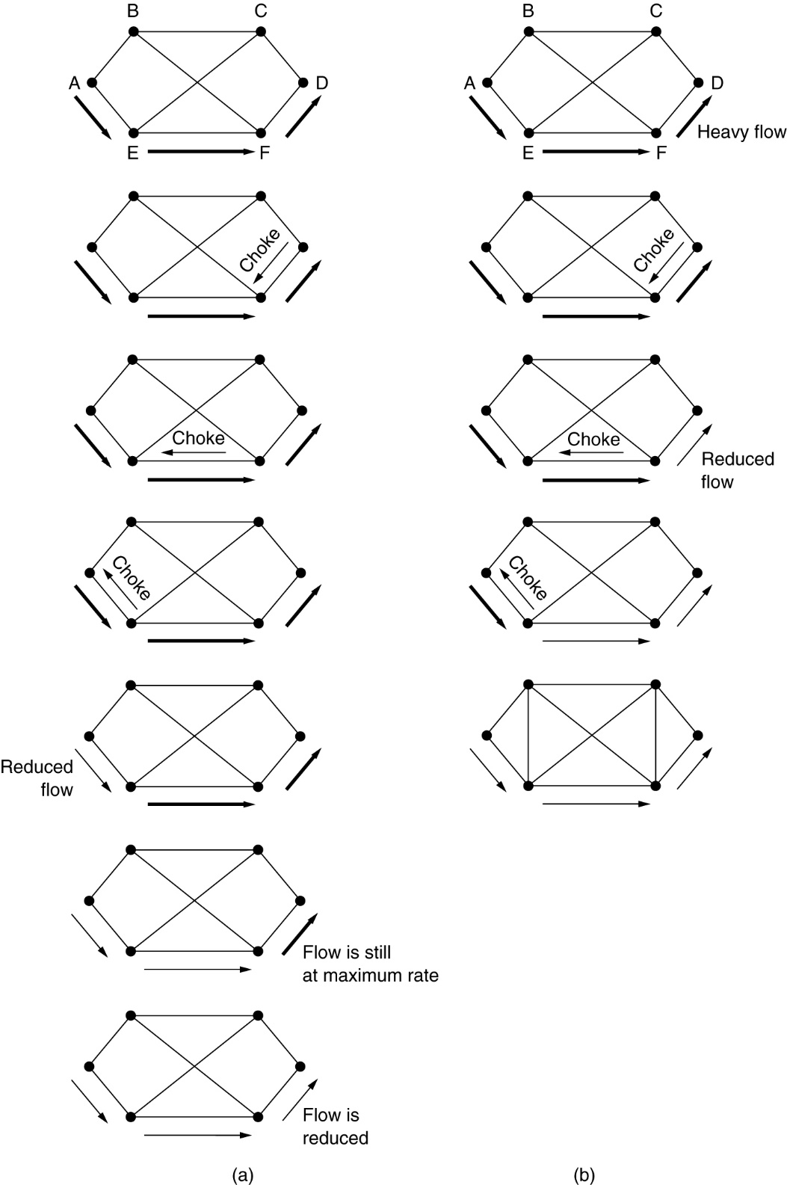
Hop-by-Hop Choke Packets
(a) A choke packet that affects only the source.
(b) A choke packet that affects each hop it passes through.

Slide 31
Other techniques
(a) Load Shedding
(b) Jitter control

Slide 32
24-5 QUALITY OF SERVICE
Quality of service (QoS) is an internetworking issue that has been discussed more than defined. We can informally define quality of service as something a flow seeks to attain.

Slide 33
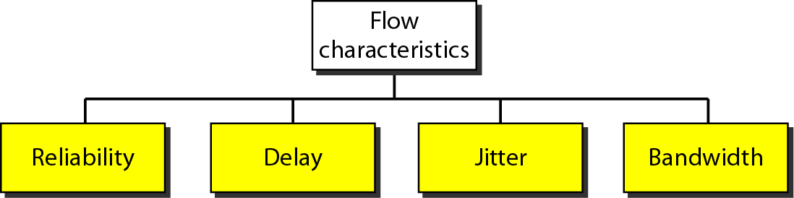
Figure 24.15 Flow characteristics

Slide 34
24-6 TECHNIQUES TO IMPROVE QoS
In Section 24.5 we tried to define QoS in terms of its characteristics. In this section, we discuss some techniques that can be used to improve the quality of service. We briefly discuss four common methods: scheduling, traffic shaping, admission control, and resource reservation.
Topics discussed in this section:
Scheduling Traffic Shaping Resource Reservation
Admission Control

Slide 35
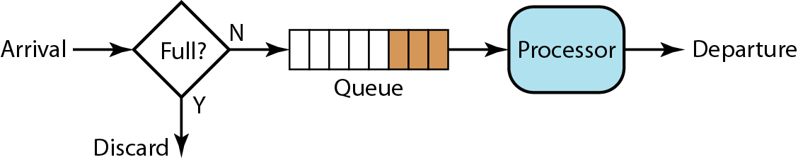
1.1 Scheduling - FIFO
Figure 24.16 FIFO queue

Slide 36
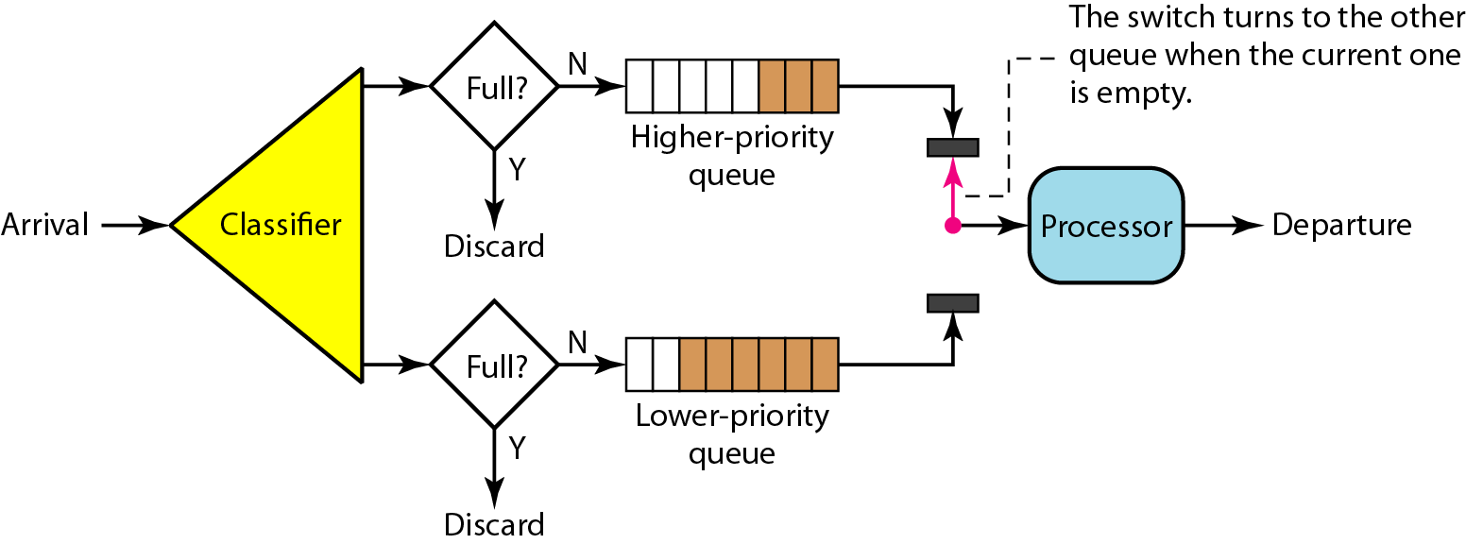
1. 2 Scheduling – Priority queuing
Figure 24.17 Priority queuing

Slide 37
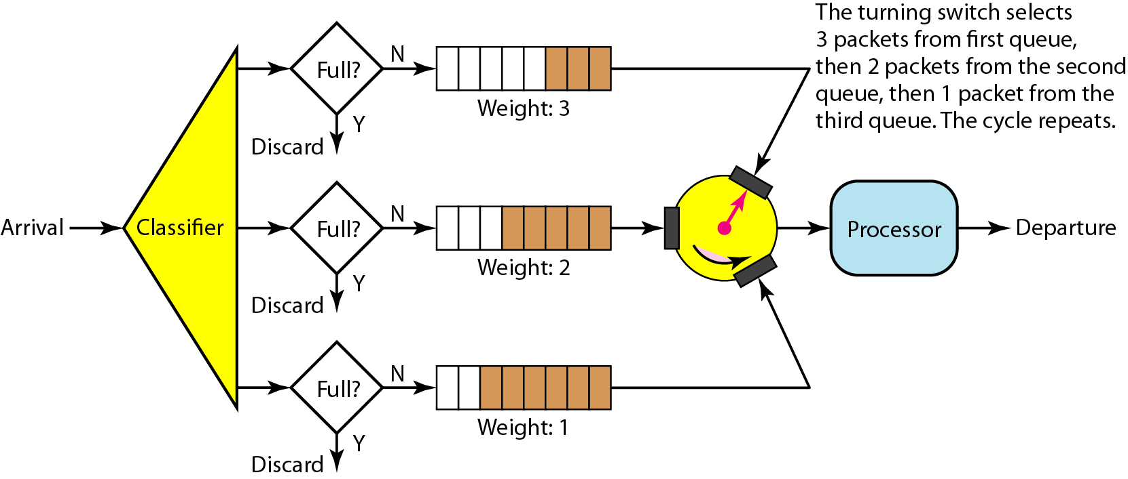
1. 3 Scheduling – Weighted Fair queuing
Figure 24.18 Weighted fair queuing

Slide 38
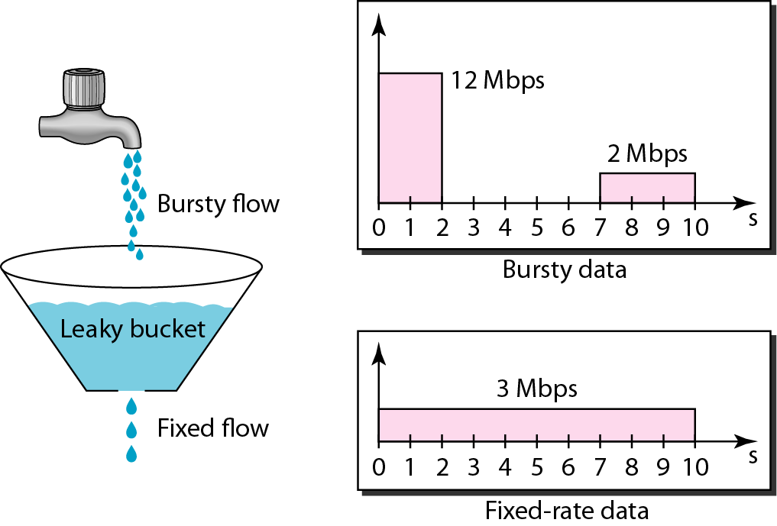
2.1 Traffic Shaping – Leaky bucket
Figure 24.19 Leaky bucket

Slide 39
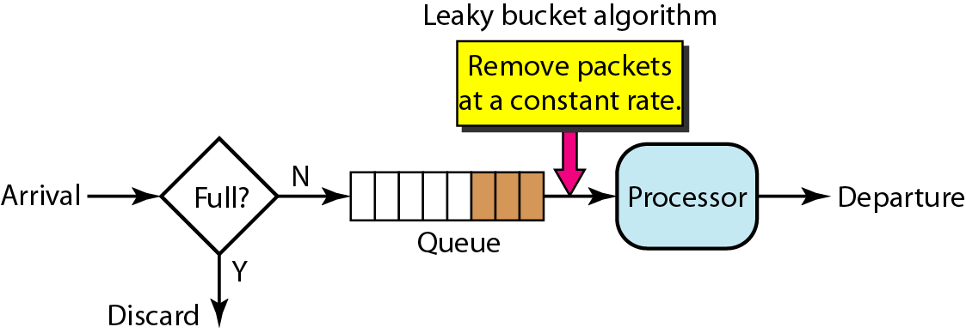
Figure 24.20 Leaky bucket implementation

Slide 40
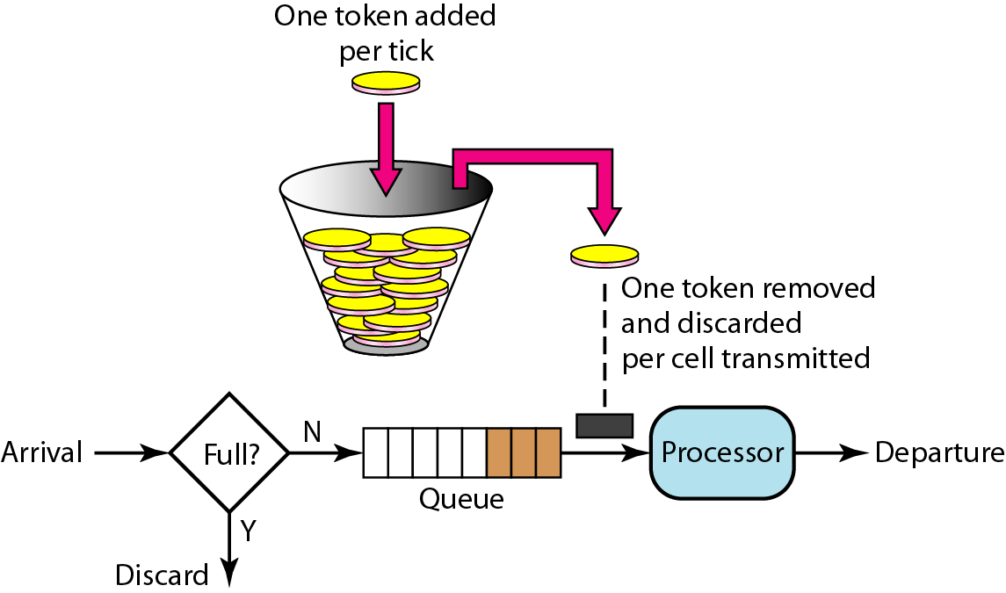
2.2 Traffic Shaping – Token bucket
Figure 24.21 Token bucket

Slide 41

Note
A leaky bucket algorithm shapes bursty traffic into fixed-rate traffic by averaging the data rate. It may drop the packets if the bucket is full.
The token bucket allows bursty traffic at a regulated maximum rate.

Slide 42
3. Resource Reservation – RSVP Protocol
Multicast Trees
Receiver-Based Reservation
RSVP Messages
Path messages
Resv messages
Reservation merging

Slide 43
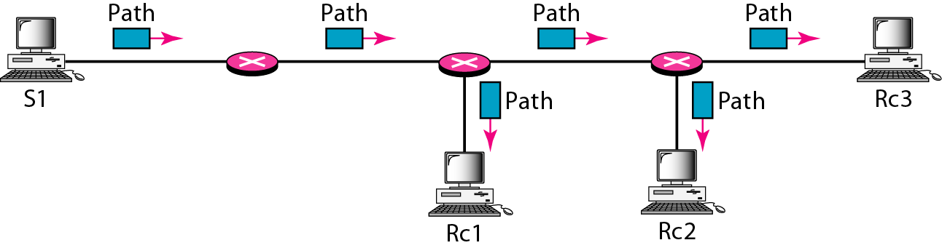
Figure 24.22 Path messages

Slide 44
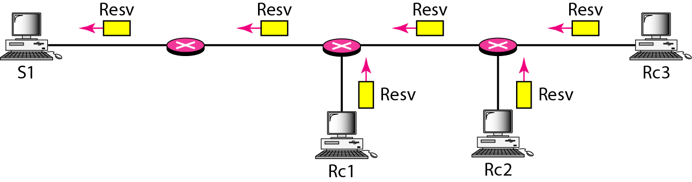
Figure 24.23 Resv messages

Slide 45
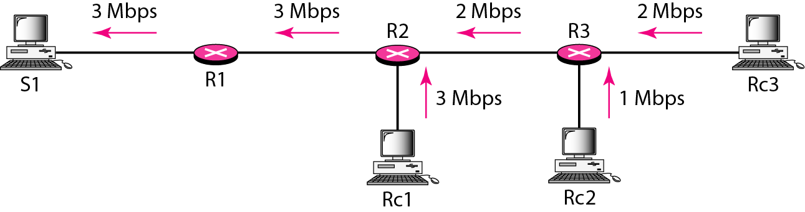
Figure 24.24 Reservation merging

Slide 46
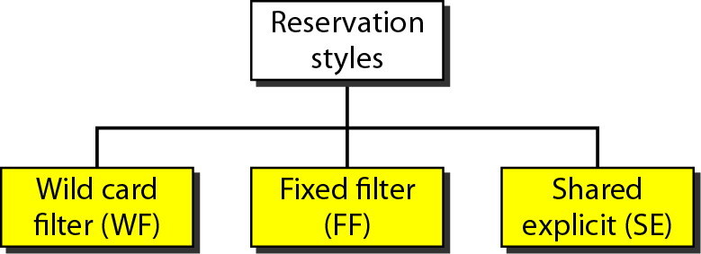
Figure 24.25 Reservation styles

Slide 47
4. Admission Control
The device decides whether to accept or reject a flow, based on predefined parameters
Before processing, these parameters are checked; in order to see if, its capacity and its previous commitments to other flows, can handle the new flow.
Capacity means in terms of bandwidth, buffer size, CPU speed etc.

Slide 48
The Example Protocol – OSPF
Open Shortest Path First
Areas – Collection of networks, host and routers all contained within an autonomous system
Area Border routers
Backbone & Backbone routers
Virtual link
Area identification
Metric
Types of links

Slide 49
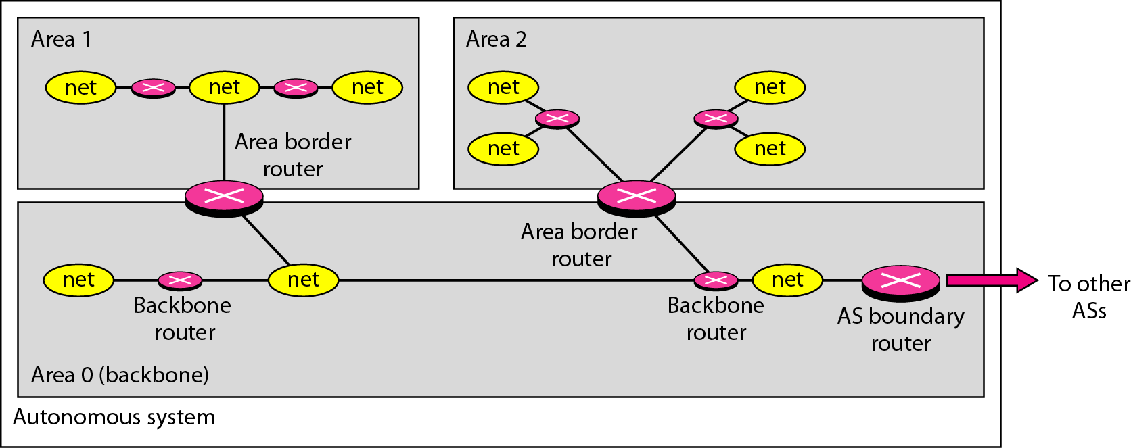
Figure 22.24 Areas in an autonomous system

Slide 50
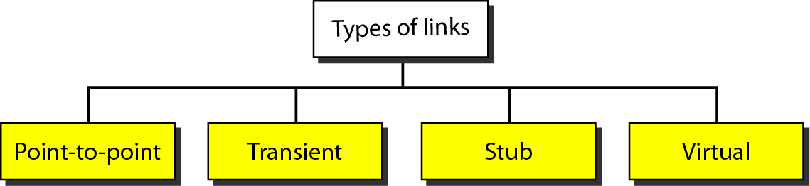
Figure 22.25 Types of links

Slide 51
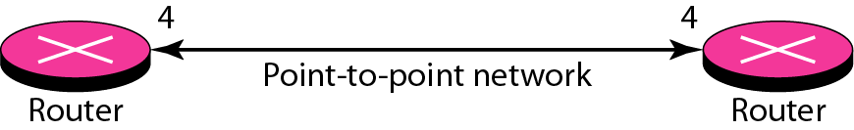
Figure 22.26 Point-to-point link

Slide 52
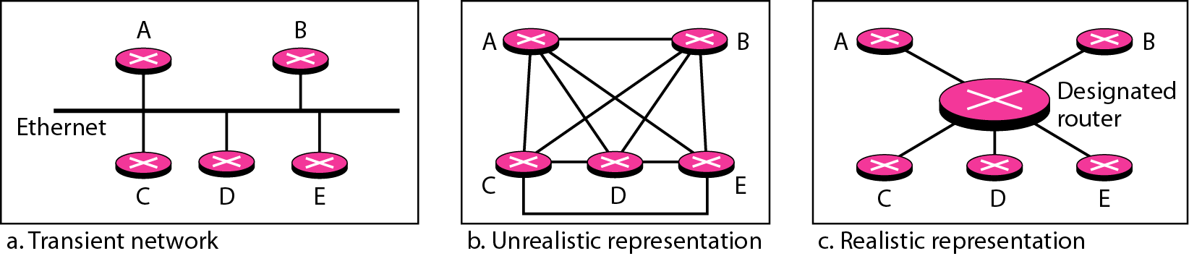
Figure 22.27 Transient link

Slide 53
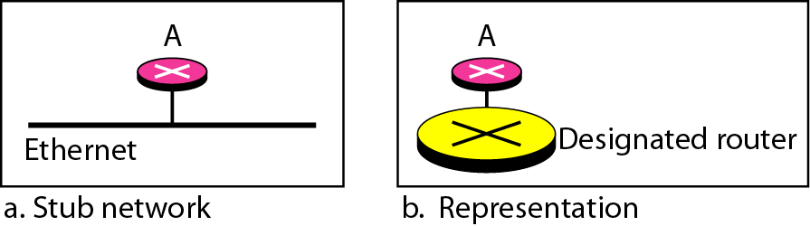
Figure 22.28 Stub link

Slide 54
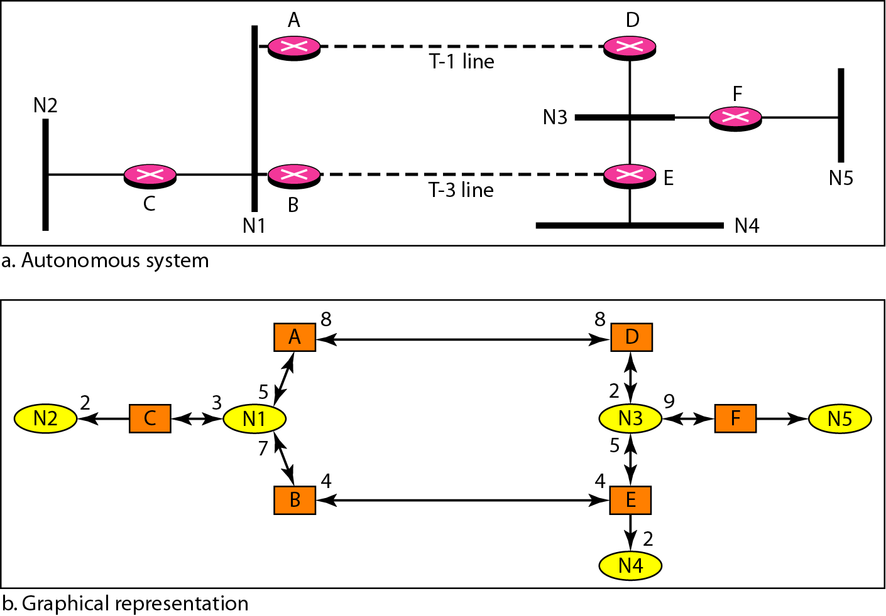
Figure 22.29 Example of an AS and its graphical representation in OSPF

Slide 55
The Example Protocol – BGP
Border Gateway Protocol

Slide 56
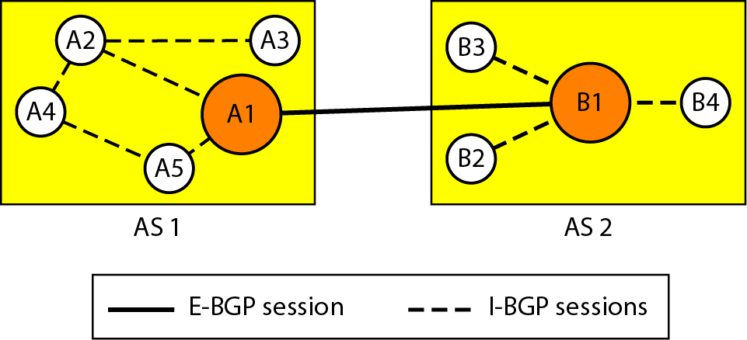
Figure 22.32 Internal and external BGP sessions

Slide 57

Chapter 20
Network Layer:
Internet Protocol
Copyright © The McGraw-Hill Companies, Inc. Permission required for reproduction or display.

Slide 58
20-2 IPv4
The Internet Protocol version 4 (IPv4) is the delivery mechanism used by the TCP/IP protocols.
Topics discussed in this section:
Datagram Fragmentation Checksum
Options

Slide 59
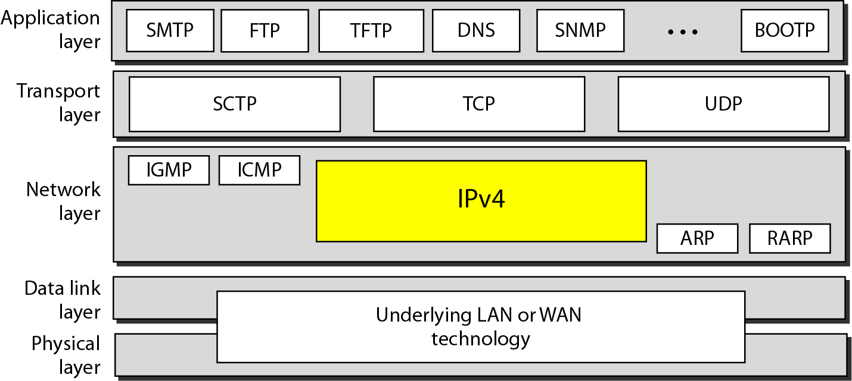
Figure 20.4 Position of IPv4 in TCP/IP protocol suite

Slide 60
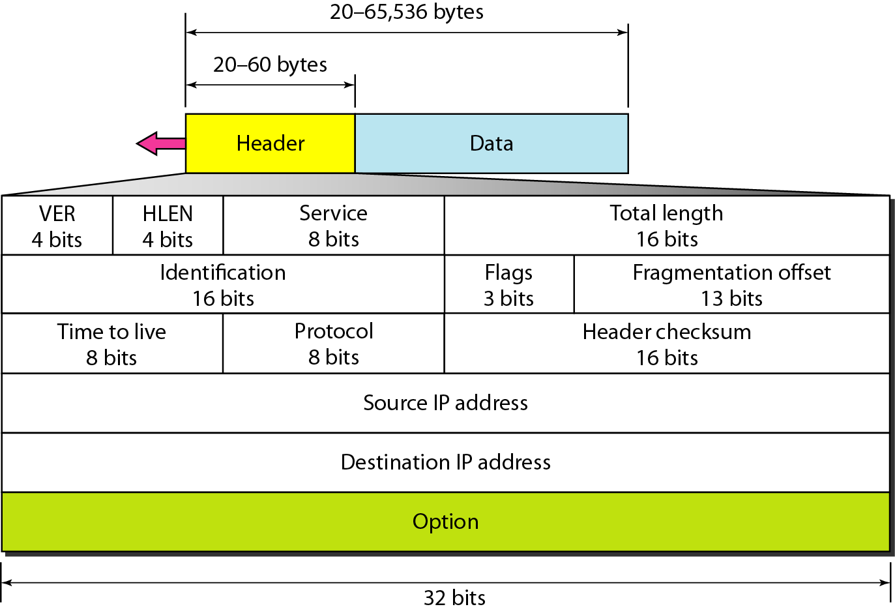
Figure 20.5 IPv4 datagram format

Slide 61
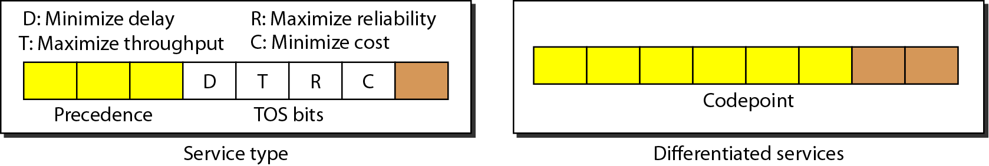
Figure 20.6 Service type or differentiated services

Slide 62
Table 20.1 Types of service

Slide 63
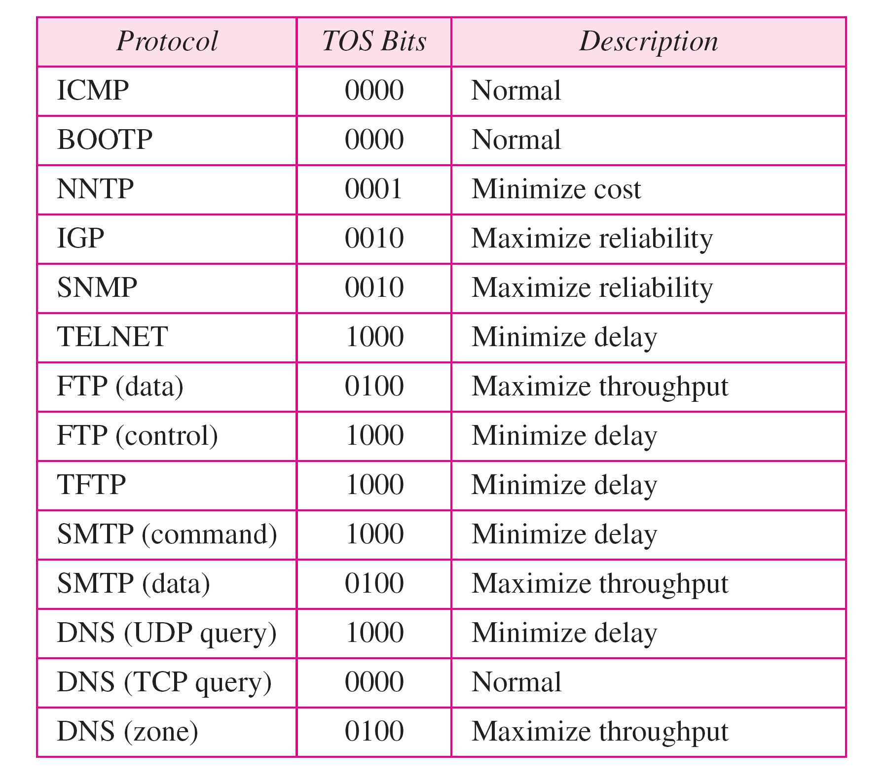
Table 20.2 Default types of service

Slide 64
Table 20.3 Values for codepoints

Slide 65
Note
The total length field defines the total length of the datagram including the header.

Slide 66
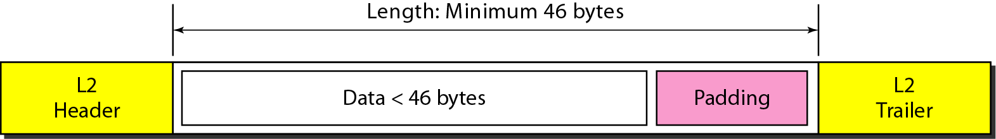
Figure 20.7 Encapsulation of a small datagram in an Ethernet frame

Slide 67
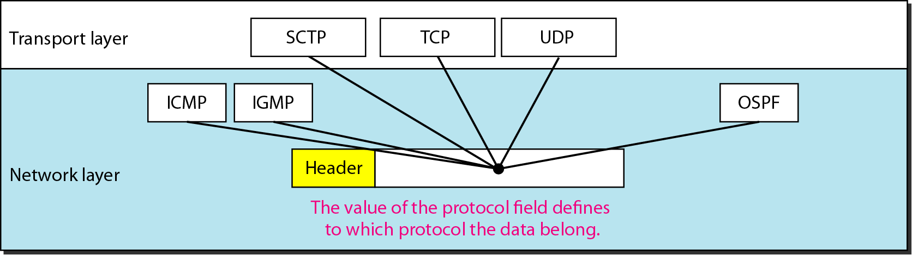
Figure 20.8 Protocol field and encapsulated data

Slide 68
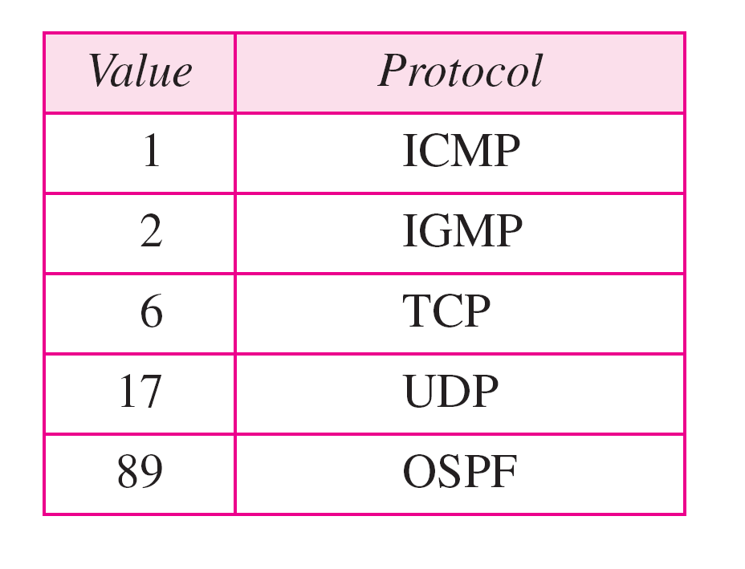
Table 20.4 Protocol values

Slide 69
Example 20.1
An IPv4 packet has arrived with the first 8 bits as shown:
01000010
The receiver discards the packet. Why?
Solution
There is an error in this packet. The 4 leftmost bits (0100) show the version, which is correct. The next 4 bits (0010) show an invalid header length (2 × 4 = 8). The minimum number of bytes in the header must be 20. The packet has been corrupted in transmission.

Slide 70
Example 20.2
In an IPv4 packet, the value of HLEN is 1000 in binary. How many bytes of options are being carried by this packet?
Solution
The HLEN value is 8, which means the total number of bytes in the header is 8 × 4, or 32 bytes. The first 20 bytes are the base header, the next 12 bytes are the options.

Slide 71
Example 20.3
In an IPv4 packet, the value of HLEN is 5, and the value of the total length field is 0x0028. How many bytes of data are being carried by this packet?
Solution
The HLEN value is 5, which means the total number of bytes in the header is 5 × 4, or 20 bytes (no options). The total length is 40 bytes, which means the packet is carrying 20 bytes of data (40 − 20).

Slide 72
Example 20.4
An IPv4 packet has arrived with the first few hexadecimal digits as shown.
0x45000028000100000102 . . .
How many hops can this packet travel before being dropped? The data belong to what upper-layer protocol?
Solution
To find the time-to-live field, we skip 8 bytes. The time-to-live field is the ninth byte, which is 01. This means the packet can travel only one hop. The protocol field is the next byte (02), which means that the upper-layer protocol is IGMP.

Slide 73
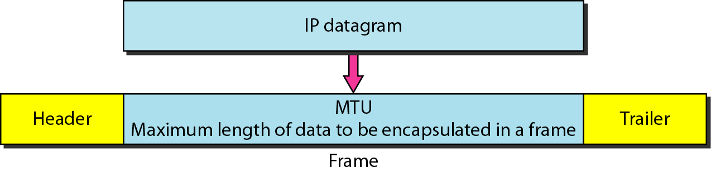
Figure 20.9 Maximum transfer unit (MTU)

Slide 74
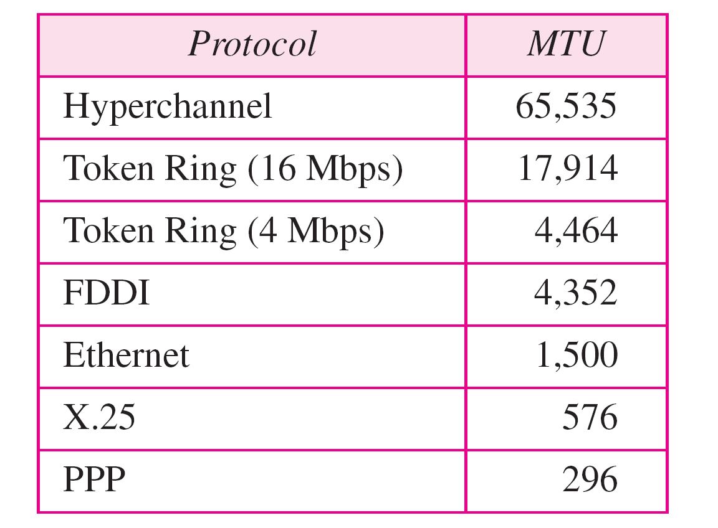
Table 20.5 MTUs for some networks

Slide 75
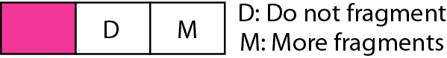
Figure 20.10 Flags used in fragmentation

Slide 76
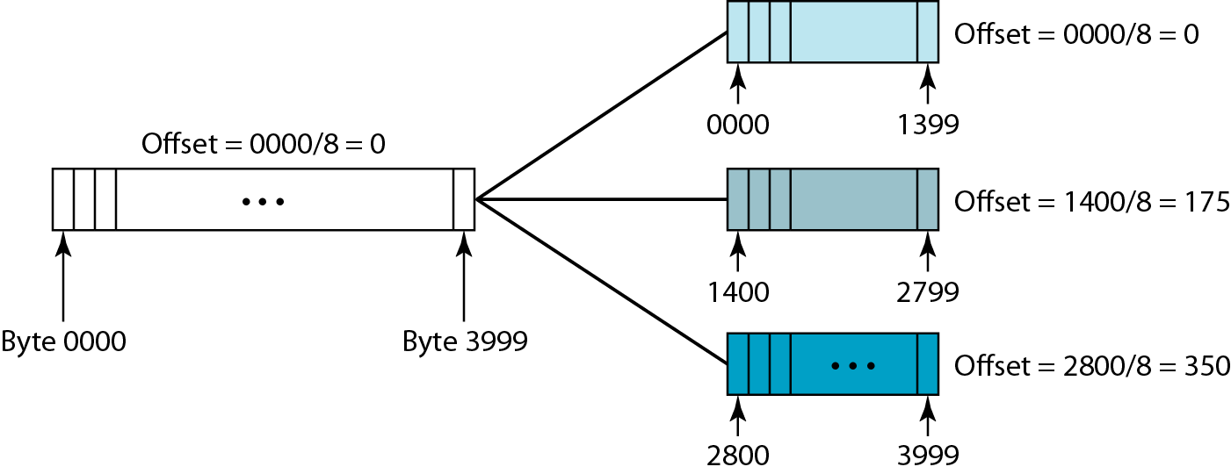
Figure 20.11 Fragmentation example

Slide 77

Figure 20.12 Detailed fragmentation example

Slide 78
Example 20.5
A packet has arrived with an M bit value of 0. Is this the first fragment, the last fragment, or a middle fragment? Do we know if the packet was fragmented?
Solution
If the M bit is 0, it means that there are no more fragments; the fragment is the last one. However, we cannot say if the original packet was fragmented or not. A non-fragmented packet is considered the last fragment.

Slide 79
Example 20.6
A packet has arrived with an M bit value of 1. Is this the first fragment, the last fragment, or a middle fragment? Do we know if the packet was fragmented?
Solution
If the M bit is 1, it means that there is at least one more fragment. This fragment can be the first one or a middle one, but not the last one. We don’t know if it is the first one or a middle one; we need more information (the value of the fragmentation offset).

Slide 80
Example 20.7
A packet has arrived with an M bit value of 1 and a fragmentation offset value of 0. Is this the first fragment, the last fragment, or a middle fragment?
Solution
Because the M bit is 1, it is either the first fragment or a middle one. Because the offset value is 0, it is the first fragment.

Slide 81
Example 20.8
A packet has arrived in which the offset value is 100. What is the number of the first byte? Do we know the number of the last byte?
Solution
To find the number of the first byte, we multiply the offset value by 8. This means that the first byte number is 800. We cannot determine the number of the last byte unless we know the length.

Slide 82
Example 20.9
A packet has arrived in which the offset value is 100, the value of HLEN is 5, and the value of the total length field is 100. What are the numbers of the first byte and the last byte?
Solution
The first byte number is 100 × 8 = 800. The total length is 100 bytes, and the header length is 20 bytes (5 × 4), which means that there are 80 bytes in this datagram. If the first byte number is 800, the last byte number must be 879.

Slide 83
Example 20.10
Figure 20.13 shows an example of a checksum calculation for an IPv4 header without options. The header is divided into 16-bit sections. All the sections are added and the sum is complemented. The result is inserted in the checksum field.

Slide 84

Figure 20.13 Example of checksum calculation in IPv4

Slide 85

Figure 20.14 Taxonomy of options in IPv4

Slide 86
20-3 IPv6
The network layer protocol in the TCP/IP protocol suite is currently IPv4. Although IPv4 is well designed, data communication has evolved since the inception of IPv4 in the 1970s. IPv4 has some deficiencies that make it unsuitable for the fast-growing Internet.
Topics discussed in this section:
Advantages Packet Format Extension Headers

Slide 87

Figure 20.15 IPv6 datagram header and payload

Slide 88

Figure 20.16 Format of an IPv6 datagram

Slide 89
Table 20.6 Next header codes for IPv6

Slide 90

Table 20.9 Comparison between IPv4 and IPv6 packet headers

Slide 91
20-4 TRANSITION FROM IPv4 TO IPv6
Because of the huge number of systems on the Internet, the transition from IPv4 to IPv6 cannot happen suddenly. It takes a considerable amount of time before every system in the Internet can move from IPv4 to IPv6. The transition must be smooth to prevent any problems between IPv4 and IPv6 systems.
Topics discussed in this section:
Dual Stack Tunneling Header Translation

Slide 92

Figure 20.18 Three transition strategies

Slide 93

Figure 20.19 Dual stack

Slide 94

Figure 20.20 Tunneling strategy

Slide 95

Figure 20.21 Header translation strategy

Slide 96
Table 20.11 Header translation

Slide 97
19-1 IPv4 ADDRESSES
An IPv4 address is a 32-bit address that uniquely and universally defines the connection of a device (for example, a computer or a router) to the Internet.

Slide 98

Figure 19.1 Dotted-decimal notation and binary notation for an IPv4 address

Slide 99
Example 19.1
Change the following IPv4 addresses from binary notation to dotted-decimal notation.
Solution
We replace each group of 8 bits with its equivalent decimal number (see Appendix B) and add dots for separation.

Slide 100
Example 19.2
Change the following IPv4 addresses from dotted-decimal notation to binary notation.
Solution
We replace each decimal number with its binary equivalent (see Appendix B).

Slide 101
Example 19.3
Find the error, if any, in the following IPv4 addresses.
Solution
a. There must be no leading zero (045).
b. There can be no more than four numbers.
c. Each number needs to be less than or equal to 255.
d. A mixture of binary notation and dotted-decimal notation is not allowed.

Slide 102

Figure 19.2 Finding the classes in binary and dotted-decimal notation

Slide 103
Example 19.4
Find the class of each address.
a. 00000001 00001011 00001011 11101111
b. 11000001 10000011 00011011 11111111
c. 14.23.120.8
d. 252.5.15.111
Solution
a. The first bit is 0. This is a class A address.
b. The first 2 bits are 1; the third bit is 0. This is a class C address.
c. The first byte is 14; the class is A.
d. The first byte is 252; the class is E.

Slide 104
Table 19.1 Number of blocks and block size in classful IPv4 addressing

Slide 105
Table 19.2 Default masks for classful addressing

Slide 106

Figure 19.3 A block of 16 addresses granted to a small organization

Slide 107
Note
In IPv4 addressing, a block of addresses can be defined as
x.y.z.t /n
in which x.y.z.t defines one of the addresses and the /n defines the mask.

Slide 108
Note
The first address in the block can be found by setting the rightmost 32 − n bits to 0s.

Slide 109
Example 19.6
A block of addresses is granted to a small organization. We know that one of the addresses is 205.16.37.39/28. What is the first address in the block?
Solution
The binary representation of the given address is
11001101 00010000 00100101 00100111
If we set 32−28 rightmost bits to 0, we get
11001101 00010000 00100101 0010000
or 205.16.37.32.
This is actually the block shown in Figure 19.3.

Slide 110
Note
The last address in the block can be found by setting the rightmost 32 − n bits to 1s.

Slide 111
Example 19.7
Find the last address for the block in Example 19.6.
Solution
The binary representation of the given address is
11001101 00010000 00100101 00100111
If we set 32 − 28 rightmost bits to 1, we get
11001101 00010000 00100101 00101111
or
205.16.37.47
This is actually the block shown in Figure 19.3.

Slide 112
Note
The number of addresses in the block can be found by using the formula 2^{32−n}.

Slide 113
Example 19.8
Find the number of addresses in Example 19.6.
Solution
The value of n is 28, which means that number of addresses is 2 ³²⁻²⁸ or 16.

Slide 114

Figure 19.10 A NAT implementation

Slide 115

Figure 19.11 Addresses in a NAT

Slide 116

Figure 19.12 NAT address translation

